Slide 1

TermEZ
Terminal Programming
made EASY
Developers
AO Navin Kumar 22BCE1020
Meghna Varma 22BCE5085
Sriram B. Swami 22BCE5103

Slide 2
Abstract
In the continuously evolving world of programming, the number of aspiring developers is only increasing.
To encourage the pursuit of software engineering, the provision of a smooth shell programming experience for beginners as well as experienced programmers with a user-friendly and efficient terminal shell is essential.
This project aims to design a terminal shell that focuses more on user interface and optimized commands to cater to the needs of a larger group of programmers that don’t want to use the same old bland terminal shells.

Slide 3
Why this project?
Everyone starts somewhere. But no one wants to start with a black and white command prompt terminal that is difficult to learn with.
When we ourselves were novices in the programming field, we would have certainly preferred to have a clear understanding of how to work around a terminal shell. In fact, even now, who doesn’t want a nicer programming experience?
Starting as only a baseline for the project, we foresee this terminal design having a larger scope with several features to optimize the user experience.
After a few test runs, we will be able to gain more insights and feedback to upgrade the design even further.

Slide 4
High level design
Window made using tkinter with components from customtkinter.
Contains a button to run the inputted commands and a help button to display preprogrammed commands and their descriptions.
Contains a button to toggle between dark and light mode.
Terminal View: Main window of the terminal.
Command is extracted from the command line and processed to provide an output in the terminal window.
History View: Previously run commands are stored here using an array
Help window: Comprehensive documentation explaining each command line function with their respective usages.
Directory: Contains a sub window to display the current working directory
Widgets to display dynamic CPU and memory utilisation metrics. Additionally, multithreading is used to provide concurrency
Scalability: Scope for addition of customisable commands to suit the user’s personal requirements

Slide 5
Low level design
The terminal application is Python-based, and the graphical user interface (GUI) is constructed using the tkinter library, including custom tkinter components.
Contains 3 source files Hash.py, Back.py and Data_structures.py along with main.py for program execution.
Imports the standard modules present in python such as os,webbrowser and ctypes to enable the usage of system calls, allow display of web-based documents to users etc.
Hash.py contains the various terminal functions which are mapped to their respective command names using a hash map. It contains a variety of functions with functionalities ranging from changing the current working directory to running files written in different programming languages
Back.py contains functions to process the commands inputted by the user
Data_structures.py contains class objects implementing hash maps, circular queues and tree data structures with respective functions to get/set and enqueue/dequeue values

Slide 6
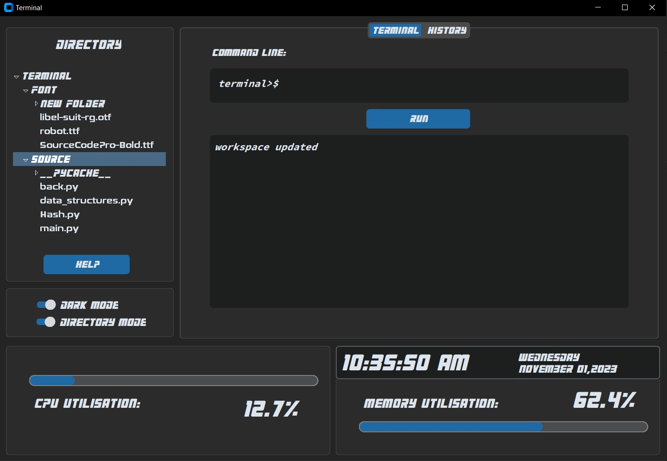
Terminal panel
Run
Button
Helpdesk button
Output dialog
Performance metrics

Slide 7
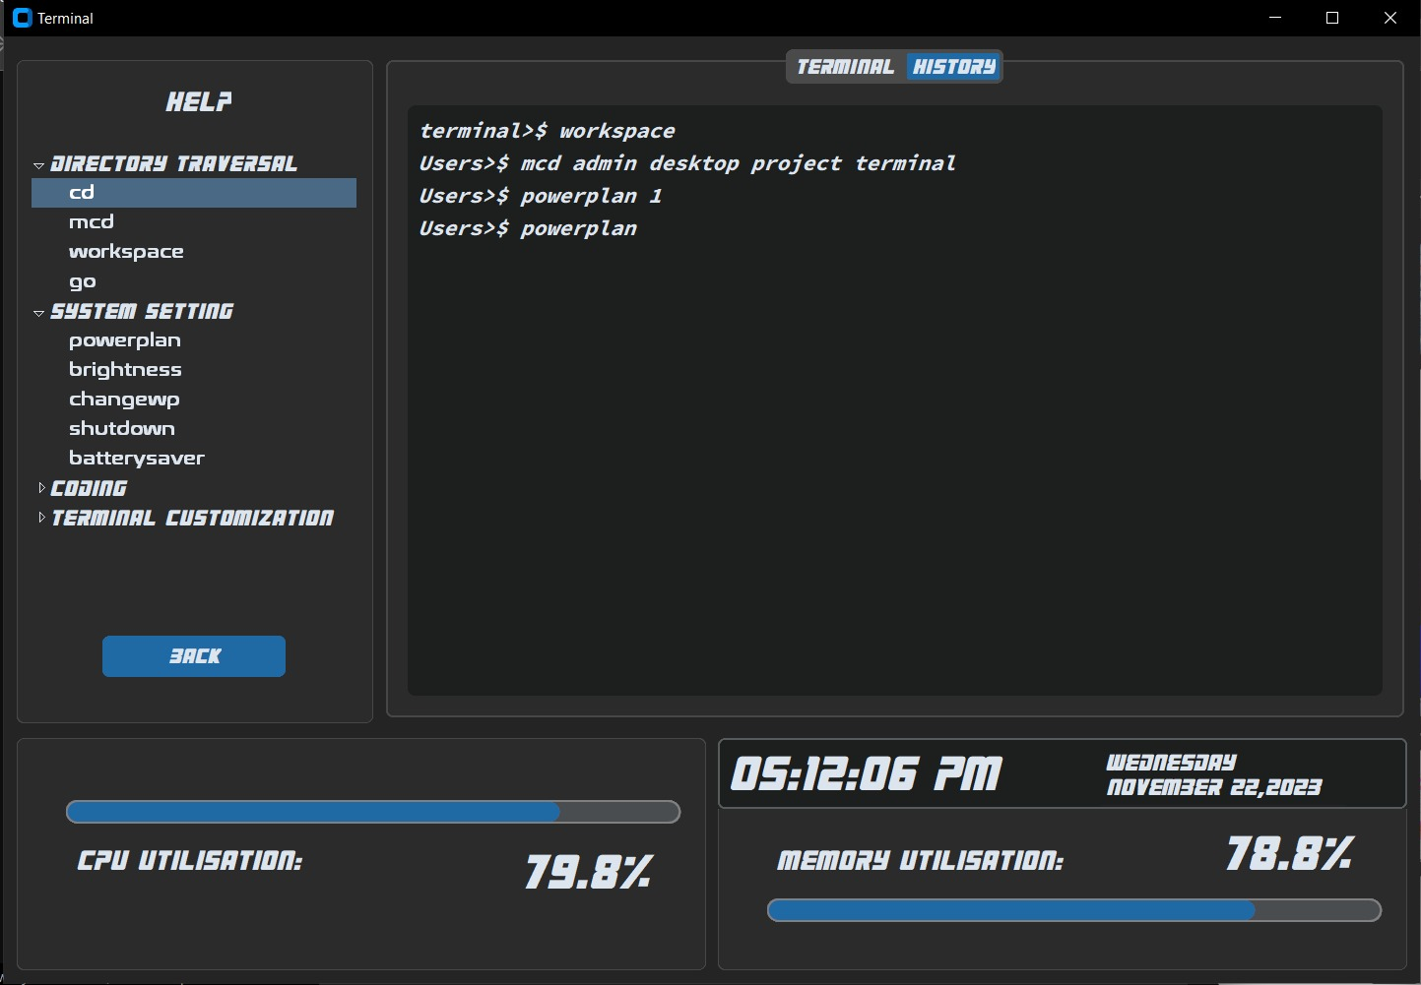
History panel
Commands
Helpdesk

Slide 8



Design features
- The software for the terminal is designed using PYTHON.
Supports various libraries such as threading and customtkinter.
Easy to review and modify
Allows creation of prototypes in relatively lesser amount of time
Open Source with Wide Community Support
- Clean User Interface:
Separate output dialog box within the terminal for greater comprehensibility.
Dark/Light mode to adjust to user preferences
- Helpdesk feature to help programmers know the commands available and the use and working of each command.

Slide 9




- Directories made simple:
Directory mode to toggle absolute path view
Sidebar view of directory and sub-folders for easy access
- Performance metrics displayed in the terminal.
CPU Utilization meter
Memory Utilization meter
- Date and time display within the window
- Navigable history feature for command line
Can traverse backward/forward through entered commands
History panel to list the past <n> commands used

Slide 10

Data structures utilized
Hash map
Circular Queue
Tree

Slide 11
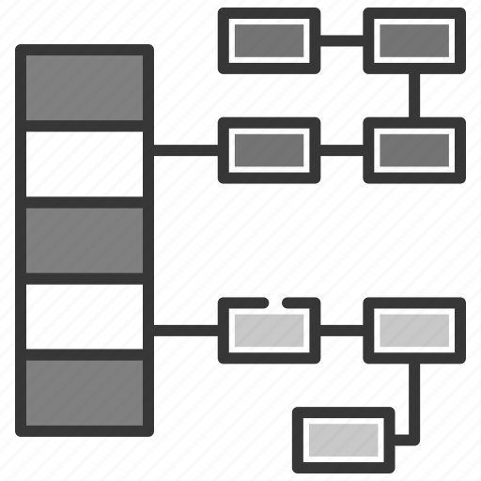
Hash map
Hash maps are data structures that are used to store data in a key-value format
A Hash function is the core of implementing a hash map. A hash function is a function that takes "key" as input and returns a "hash value" or "hash" as a fixed-size output. The main importance of a hash function is that you can give the same input and the function will always produce the same output. This is important because it allows the hash map to quickly determine where a particular key-value pair should be stored in the map.
It contains two functions namely get and set. Get method of HashMap class is used to retrieve or fetch the value mapped by a particular key mentioned in the parameter. It returns NULL when the map contains no such mapping for the key.
Set on the other hand is used to add key-value pairs to a hash table, handling collisions by storing multiple pairs with the same hash index in a list.
Usage:
Hash mapping is used to pair the commands with its functions.
Hash mapping is also used to program the aliasing feature to keep track of the aliases in the terminal shell.
Aliases (user-defined shortcuts) are executed efficiently using hash maps
For each alias registered, the hash map resolves it to the underlying command or series of commands, ensuring rapid execution
A hash map is used to set up the help desk feature and provide help to the users regarding their required commands.
Each command is paired with relevant information, including usage instructions, examples, and explanations.
When a command is enquired, the hash map is able to quickly retrieve and display the associated documentation
Clear, Easy Mapping:
For command-function mapping, alias management and command documentation, hash mapping is excellent as it ensures direct mapping from the command to the function.

Slide 12
Why HASH MAP?
Swift Command Lookup:
Hash maps are the way to go for quick data retrieval in a resource-efficient manner.
Hash maps allow for constant-time lookups using key value pairs with O(1) time complexity.
Efficient Space Utilization:
Hash maps can effectively manage memory, dynamically allocating space for key-value pairs without wasting resources.
This is beneficial for managing a dynamic list of commands and their associated descriptions.
Error Handling:
When a user enters an invalid or unrecognized command, the hash map can quickly identify this situation, allowing the terminal to provide informative error messages or suggestions to the user.
Consistent Performance:
Hash maps offer consistent and predictable performance characteristics, regardless of the number of commands or aliases stored in the map.
This predictability is essential for maintaining a responsive and reliable terminal shell.
Customizability:
Hash maps provide a flexible structure for adding, modifying, or removing command-function mappings.
Any command can be paired with relevant information as necessary and modified with potential patches

Slide 13

Circular Queue
A circular queue is the extended version of a regular queue where the last element is connected to the first element. Circular Queue works by the process of circular increment i.e. when we try to increment the pointer and we reach the end of the queue, we start from the beginning of the queue.
A circular queue performs two major operations enqueue and dequeue. The former inserts elements into the queue whereas the latter deletes elements from the queue
It also contains two pointers : front and rear which take care of the first and last element of the queue respectively
Usage:
The circular queue is used to track the command line history.
Each command entered is added to the circular queue.
The terminal command history is limited to a size of <n> lines for simplicity.
When backtracking, it is easy to go back to the latest command since the queue is looped.

Slide 14
Why circular queue?
Memory-Efficient:
Circular queues don't waste memory by leaving gaps between elements or needing reallocation when the number of commands increase.
They make efficient use of memory, which is important in resource-constrained environments.
Constant Time Complexity:
Enqueueing and dequeueing operations are efficient since they have a fixed time complexity.
Command history lookup does not have noticeable delays.
Constant Space Complexity:
Circular queues maintain a fixed amount of memory regardless of the number of elements in the queue.
Helps keep memory allocation controlled and predictable to better the performance of the terminal.
Order Retention:
FIFO order is used in circular queues and hence the command history is maintained in the same order as executed.
Navigation through the command history is simplified for the user.

Slide 15

Tree
A tree is an abstract data type which represents a nonlinear hierarchical data structure that consists of nodes connected by edges.
Each node in the tree can be connected to many children (depending on the type of tree), but must be connected to exactly one parent, except for the root node, which has no parent. The nodes which have no children are called leaf nodes .
The nodes are connected to each other through pointers which allow traversal from one node to another. The height of a node is the length of the longest downward path to a leaf from that node. The height of the root is the height of the tree. The depth of a node is the length of the path to its root.
Usage:
Directory path storage
The directories behave like parent nodes with the files within them acting like children nodes.
A class Treenode is defined to store absolute path of the file, file name, number of files within the folder and pointers to all the files
Tree-view widget
widget integrated to provide a visual representation of the hierarchical structure of directories and files within the system
Distinct font styles employed to distinguish between files and folders

Slide 16
Modules Used
1. Command Line | Output Dialog
2. Directory Management
3. Helpdesk
4. Function Set
5. History
6. Performance Metrics
7. Toggles

Slide 17
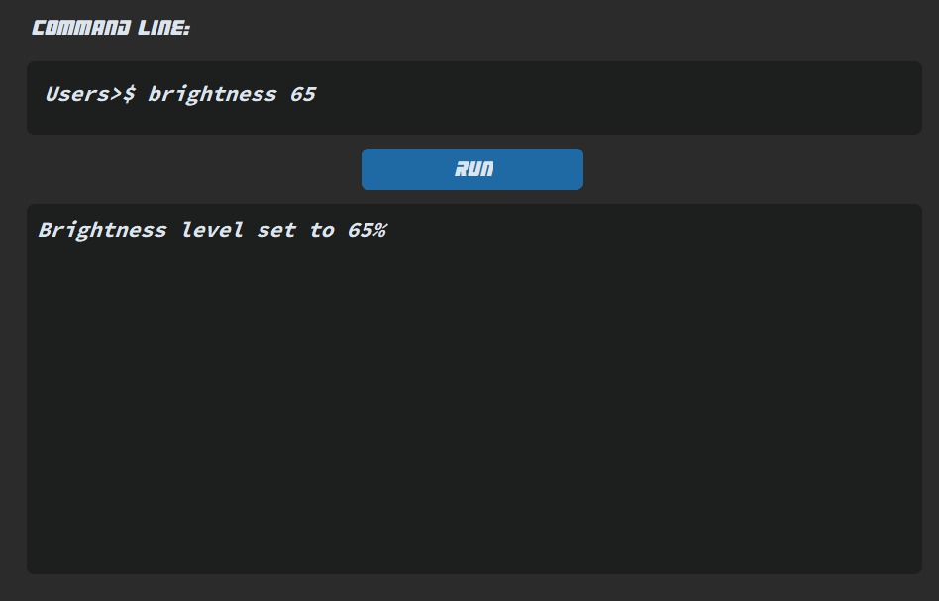
1. Command line | Output dialog
Input
User enters a valid command into the command line
After entering the command, the user clicks on the “RUN” button, and this begins the command processing.
Processing
Checks if a command has been entered.
If it has been, then it checks if the command has been aliased or unaliased.
If it hasn’t, then it checks for the command in the hash database
After it gets the command, it runs the command and prints the output.
Output
The terminal has a separate output dialog for convenience.
The output varies based on the command. It may display:
Status of command execution
Options for command
Output display for command if applicable
Error message in case of an invalid command

Slide 18
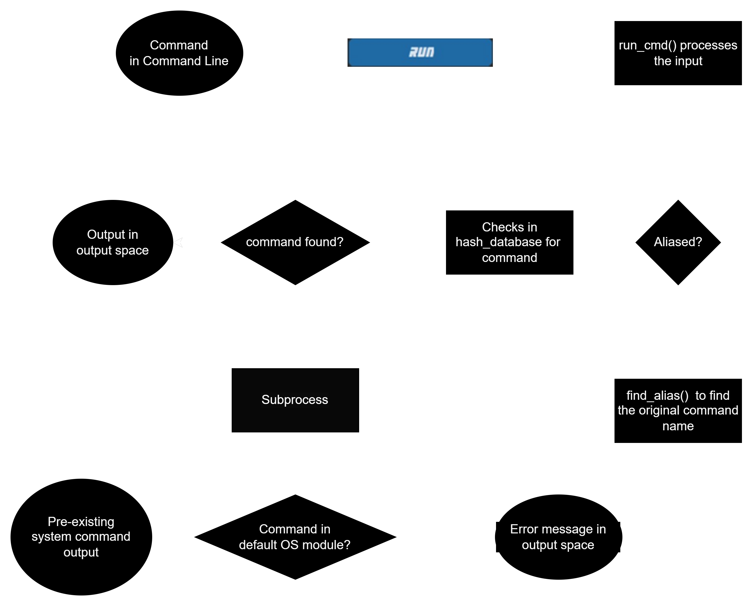

Slide 19
2. Directory management
Input
“workspace” is entered into the command line to show the directory-tree-view on the sidebar.
The user can select the folder/file from the sidebar displayed and navigate too.
Processing
Module OS has been imported for its walk function.
OS.walk() generate the file names in a directory tree by walking the tree either top-down or bottom-up. For each directory in the tree rooted at directory top (including top itself), it yields a 3-tuple (dirpath, dirnames, filenames).
These are essentially the root (specified directory), dirs (sub-directories/folders) and files (within root and directories).
For easier navigation and efficient storage, we have converted the tuple system by inserting the elements into a tree (tree class has been defined in data_structures.py).
Output
The directory-view is displayed in the sidebar and has an indented drop-down display for each folder/sub-directory.
Files and folders can be viewed and navigated through easily.
Refer Slide 6

Slide 20
3. HELP DESK
Input: User clicks on the help button in the main terminal window
Processing:
A function help_func is used to toggle between the help and directory mode
When help button is pressed, help_func is called and the mode is switched.
A dictionary hash_dict is present with the types of commands as the key and a list of commands as the value
A hashmap is used to map each command with a string explaining the commands functionality and syntax
In this hashmap,the hash function used is hash_value = (hash_value + ord(key[i]) * i) % len(data) with initial value of hash_value being 0.
When back button is pressed, it calls the back_func to switch back to the directory mode.
Output: Switches to the help subwindow from which user can see the descriptions and syntax of various terminal commands

Slide 21
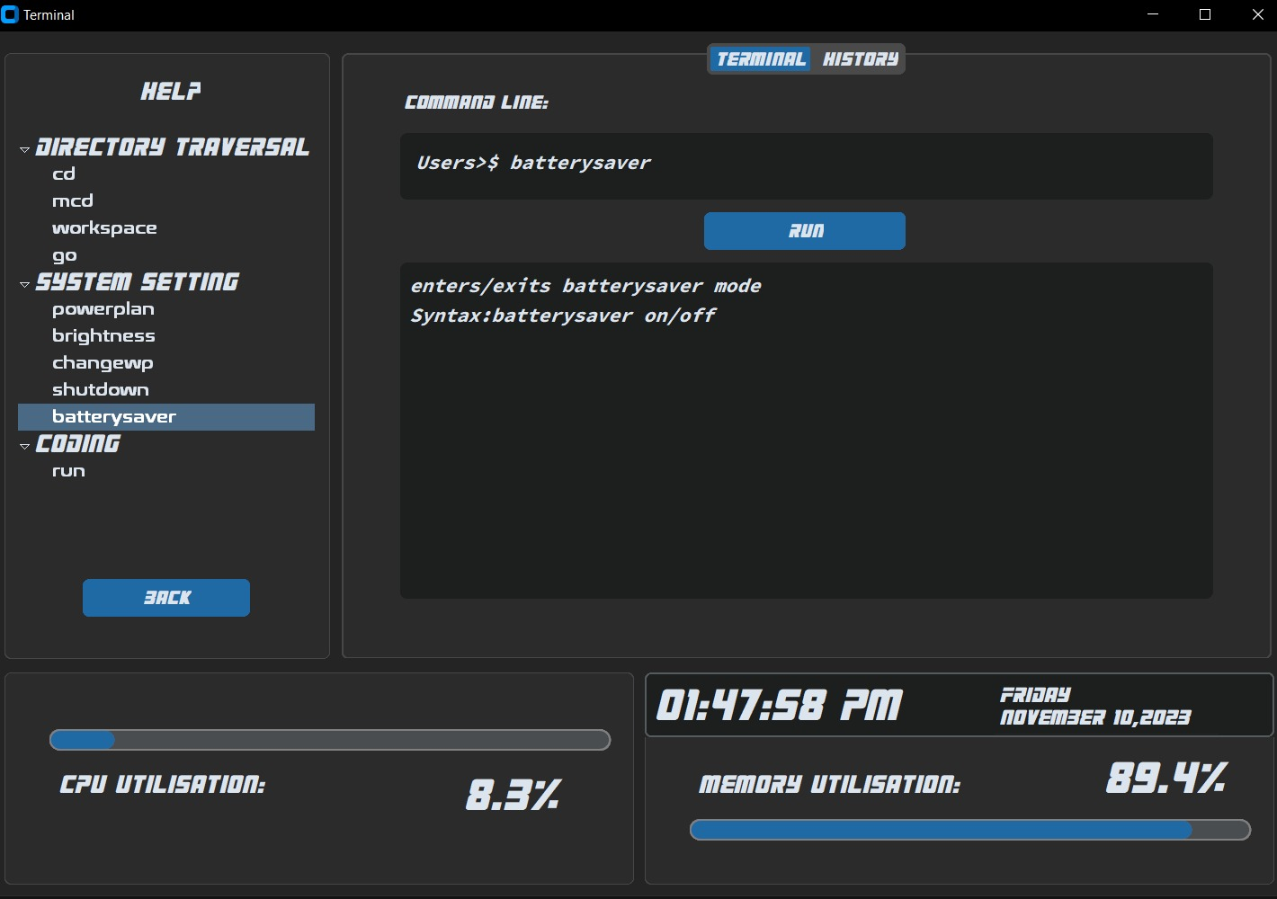

Slide 22
4. FUNCTION SET
Besides pre-existing commands, out terminal consists of several custom commands.
These functions are defined in hash.py and are implemented using a hashmap.
A nested list is used to store a string containing the name of the command as well as function itself.
This is then stored in a hash map with the key as the name of the command(in string format) and the value as the function
We can introduce as many custom commands as we want and add them to the hash map.
The current version contains the pre-existing commands along with some prototype custom commands that we have listed in the next slide.
Refer Slide 11

Slide 23
Terminal Customization
alias: aliases a given command as per users wishes
Syntax:alias new_command_nameytsearch: Opens a video in youtube
unalias: removes the given alias.
Synatx: unalias alias_name
Coding
run: Used to run different types of code files
Syntax:run file_name.extension
ytsearch: Opens a video in youtube
Syntax:ytsearch "channel_name" limit
Directory Traversal
cd: used to change directories.
Syntax: cd directory_name
mcd: used to change multiple directories at once
Syntax: mcd directory_1 directory_2 directory_3 etc
workspace: updates the working directory
Syntax: workspace
go: Can either go one directory back or can go to Home directory
Syntax: go back
Syntax: go home
System Settings
powerplan: Changes performance mode
Syntax: powerplan
4 options available
brightness: Changes the brightness settings
Syntax: brightness number
changewp: Changes the wallpaper to specified image
Syntax: changwp pic_name.jpg
shutdown: shuts down the system
Syntax: shutdown
batterysaver: enters/exits batterysaver mode
Syntax:batterysaver on
Syntax:batterysaver off

Slide 24
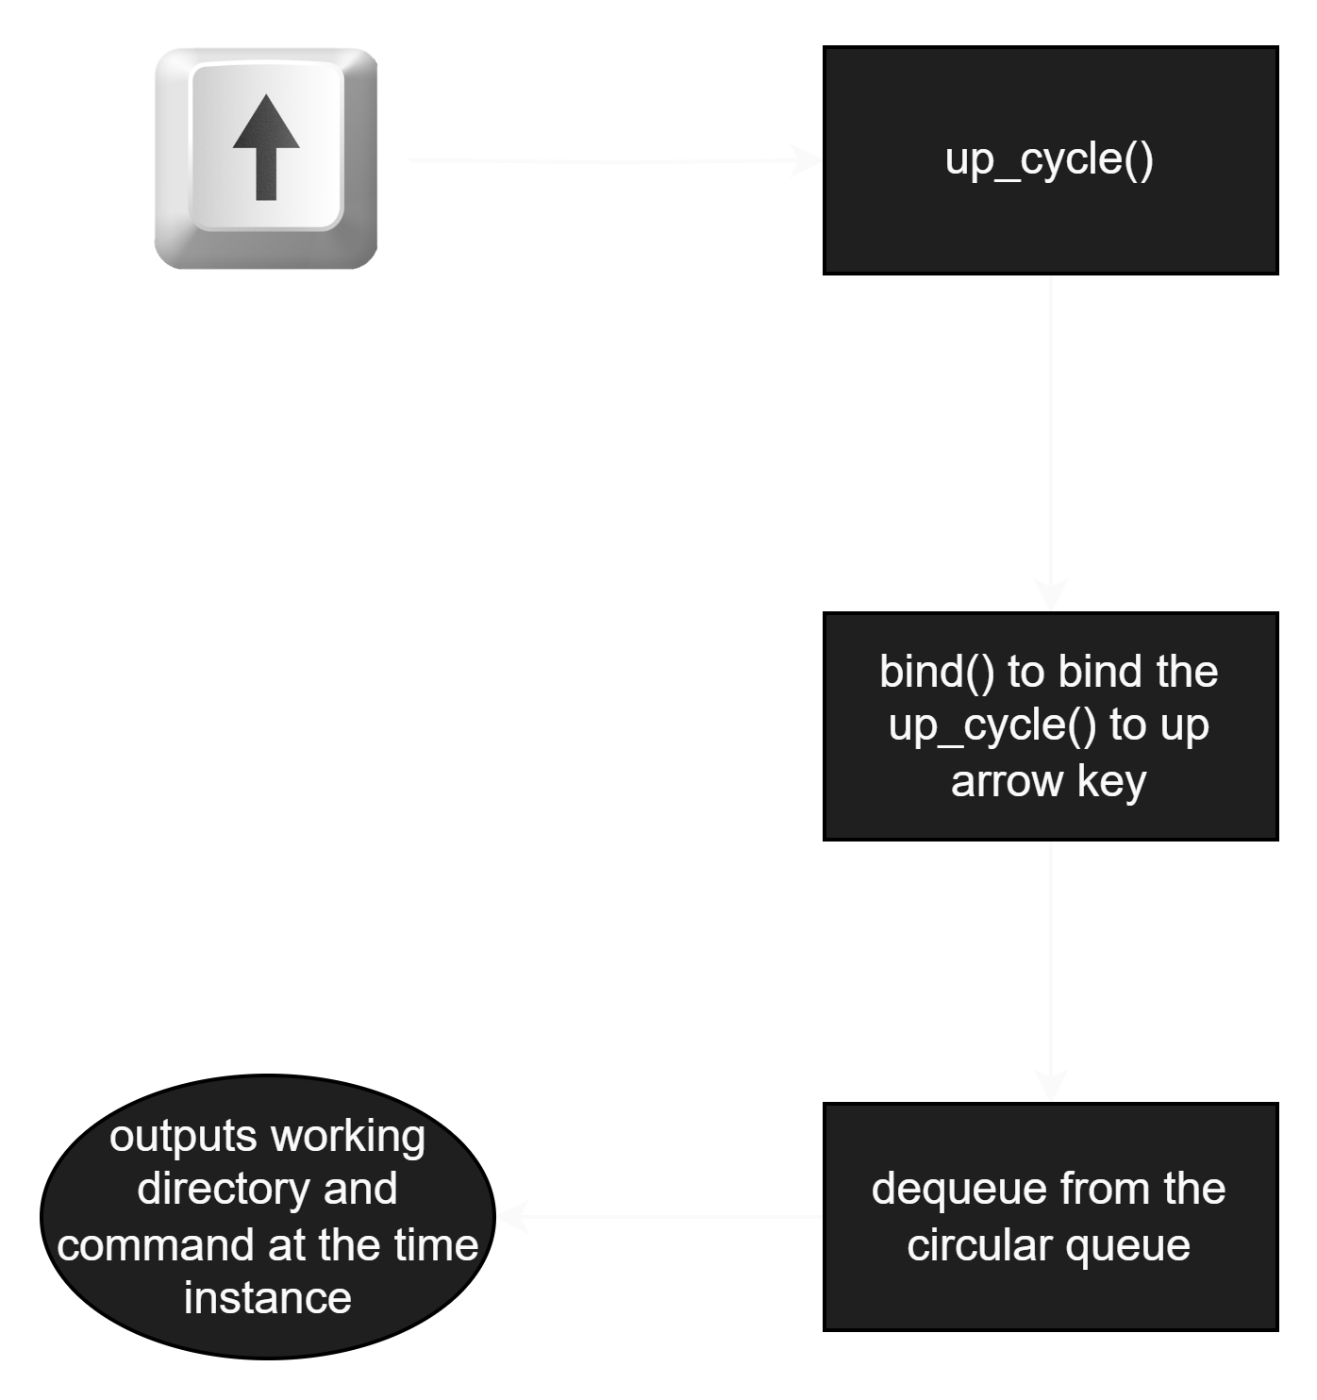
5. History
Command Recall
Input
The user when in command line, may press the up key to easily navigate through previously used(next) commands.
Processing
We have used the bind() method from the CTK library to bind the up key to access the up_cycle function.
The commands entered are stored in circular queue in sequential order so that the commands can be extracted in the same order as they were entered (using dequeue).
Since it is a circular queue, we can rotate back to the latest command.
Output
Returns the working directory and the command entered at the time instance to the command line bar.

Slide 25
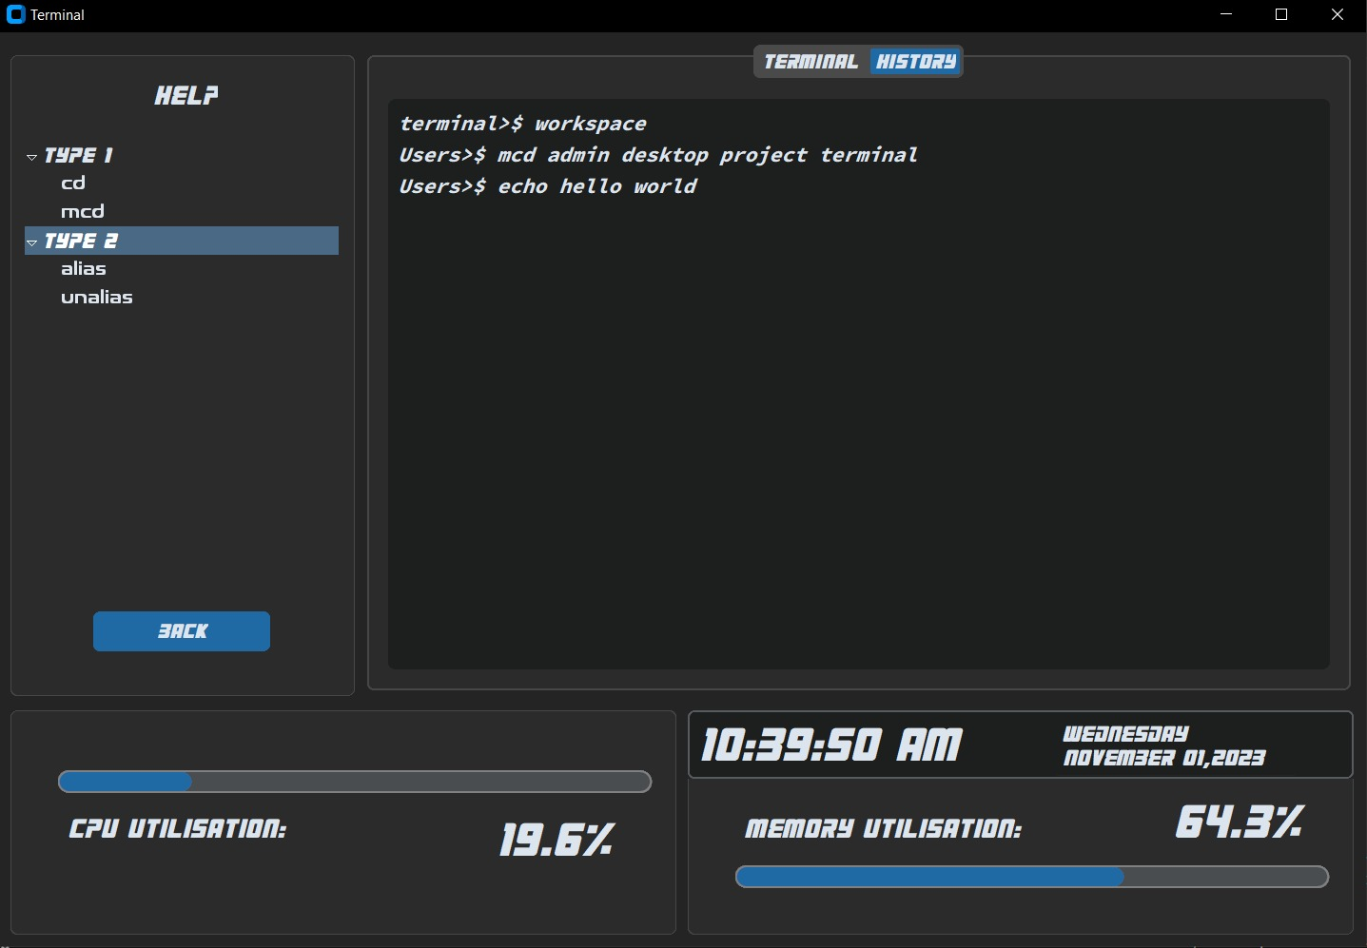
History Panel
Input
User has the option to switch from the terminal window to the history panel by clicking the “HISTORY” panel.
Processing
Using the CTkTextbox class from the CTK library, a panel window historybox is created.
Each command when run, gets appended to an array.
The array is stored in a line-by-line format in the historybox window.
Output
The historybox contents are displayed in the history panel.
The command line history is displayed in the original order.

Slide 26
6. PERFORMANCE METRICS
The Class CTkTextbox is used to create two textboxes; one for CPU utilisation, and one for memory utilisation. They are placed in the main terminal window.
The cpu_progressbar and the mem_progressbar are created as CTkProgressBar classes.
Using the Thread class from the threading module, we call the update_cpu_progress and the update_mem_progress functions concurrently and to be constantly running.
update_mem_progress():
The memory performance is captured using the virtual_memory method of the psutil module.
This is displayed in the mem_progressbar in the terminal window.
update_cpu_progress():
The CPU performance is captured using the cpu_percent method of the psutil module.
This is displayed in the cpu_progressbar in the terminal window.

Slide 27
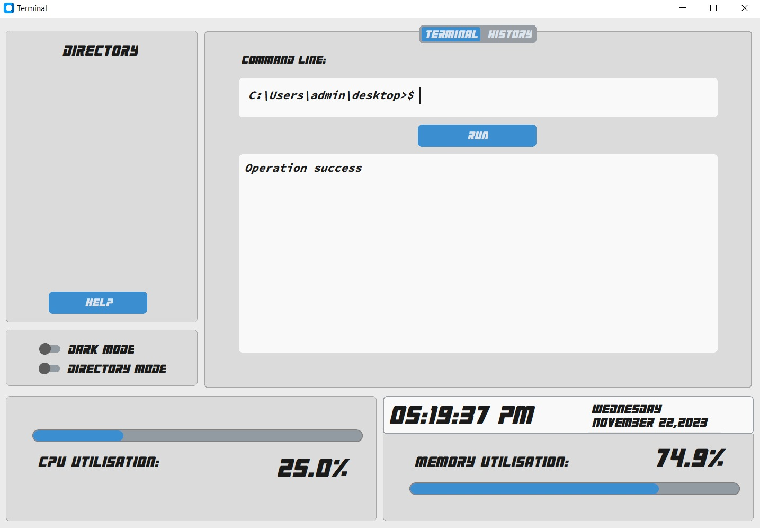
7. Toggles
Input
User can click the toggles to:
Switch between Dark Mode and Light Mode
Switch between Directory View and Path View.
Process
CTkSwitch class is used to create the switches Dark Mode and Directory Mode (Dark mode is on by default) and the toggles are places below the sidebar on the left and is referred to switch_appmode() and switch_dirmode().
Under the function definition for switch_appmode(), the theme details are set to fit a dark theme if the switch is on and set to fit a light theme if the switch is on. The text, foreground and background colours are changed.
Under the function definition for switch_dirmode(), when the switch is on, clean_cmd() is called to obtain the path and it is filtered out to the present working directory and the command line displays the filtered path. When the switch is off, clean_cmd() is called to get the full file path.
Output
Dark theme setting when Dark Mode is On. Light theme setting when Dark Mode is Off
Reduced Directory Path viewed in command line when Directory Mode is On. Full directory path viewed in command line when Directory Mode is Off.

Slide 28
What’s the point? <SIGNIFICANCE>
Terminal (command-line) programming seems dry, but it remains highly relevant in the software realm.
Terminal programs are universally compatible across different operating systems.
Scripting is done best on terminal shells and this design helps programmers have an amazing experience with it.
TermEZ is EZ:
This terminal design greatly improves the comprehensibility of shell programming.
Learning curve smoothened for beginners and terminal programming is more appealing.
TermEZ is EZ.2:
This terminal also appeals to advanced programmers with many more features, metric displays and customizations.
The elegant design and potential customization just contributes to an overall improvement in user experience.
Command line familiarity:
Command-line engineering is a crucial skill and being familiar with necessary commands is invaluable. With the help of easy comprehension and a command helpdesk available in the terminal, it is easy to get familiar.

Slide 29
Conclusion
TermEZ is a project aimed to simplify terminal programming and enhance productivity.
The design is suitable for all skill levels credited to its user-friendly interface, helpdesk feature and advanced options.
Helpful custom commands are introduced into this terminal.
The project is motivated by self-experiences as well as the realization that terminal programming and scripting is a crucial asset in the realm of software engineering
This design will incorporate feedback and feature potential patch updates by virtue of the source code’s convenenent modification design.

